Slide 1
OneOps Boot Camp 101
Intro to OneOps and Cloud Native Design

Slide 2
Our Speakers
Intro and Welcome – Rhonda Avlonitis
What is OneOps – Rupesh Bisoi
Functional OneOps Lecture – Khushboo Lohia
Monitoring – Harit Vyas
Cloud Operations -

Slide 3
Agenda
Welcome Students!
What is OneOps
Submitting a request for Quota
Navigating OneOps
The OneOps “Assembly”
The “Design” Function
The “Transition” Function
The “Operate” Function
LUNCH BREAK
Monitoring – Harit Vyas
Deployment and Hygiene
Functional Labs

Slide 4
WELCOME STUDENTS!
What to Expect?
Contributing to the OneOps Product Roadmap
Engaging the Cloud Sherpa Team
What is a Sherpa? Role, function, areas of expertise
Benefits
How to engage
Sherpa.walmart.com

Slide 5
Lifecycle Management and Cloud Native
Rupesh Bisoi – Sr. Architect

Slide 6
What is OneOps? – Rupesh Bisoi
Key Concepts of Lifecycle Management
Legacy architecture vs. Cloud architecture
What does it mean to be cloud Native
Roles and their functions (admin, user, developer)
Oneops Architecture
Platforms supported in Oneops
Requesting Capacity and being a good cloud citizen

Slide 7
Submitting a request for Quota (capacity)
Cloud standards
Managing your quota

Slide 8
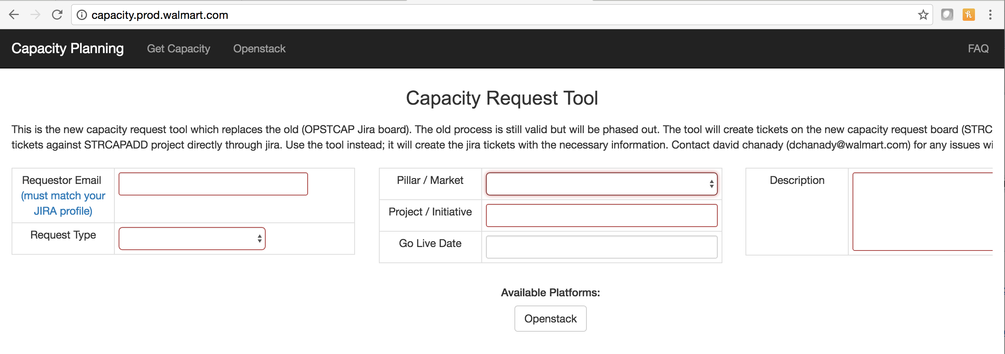
Requesting Capacity
All capacity requests for new capacity and additional expansion capacity go through the capacity management tool for GeC capacity.prod.walmart.com

Slide 9
Questions?

Slide 10
Functional OneOps
Khushboo Lohia – Product Technical Leader

Slide 11
Navigating OneOps for the first time
Login Information
Onboarding (new org/existing org)
Account Functions
Setup of user accounts
Organization Account
Org Summaries

Slide 12
The OneOps “Assembly”
What is an “Assembly”
Adding an assembly, guidelines and best practices
Managing your assembly
Notifications
Adding teams to your assembly

Slide 13
The “Design” Function
What is the “design” function
Adding a platform to a design
Editing
Variables (add, delete, modify)
How and when do I “commit”
How do I view my design releases? Why is this important?

Slide 14
The “Transition” Function
What is the “transition” function
Creating an environment, guidelines and best practices
Editing/Deleting Environments
Environment releases, why is this important?
Deployment
First time deployment, guidelines and best practices
Deployment after changes
Upgrades guidelines and best practices

Slide 15
The “Operate” Function
What Is the “operations” function used for
Understanding Graphs and data
What Is the control Environment, why is it important

Slide 16
Questions?

Slide 17
Sensu Monitoring
Harit Vyas – Staff Software Engineer

Slide 18
Monitoring – Harit Vyas
OneOps Health
Customized monitoring with Sensu pack

Slide 19
Questions?

Slide 20
Cloud Hygiene
Cleaning up assemblies that are not in use
Tech Debt reports and being a good cloud citizen
Cloud Maintenance and decommissioning

Slide 21
Cloud Maintenance and Operations
TBD – Gerald’s Team

Slide 22
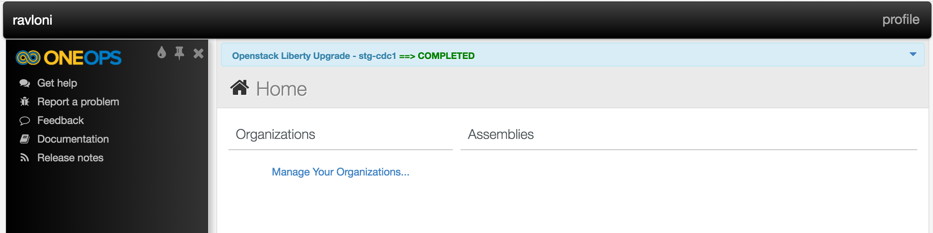
Cloud Maintenance/Decom Notifications
Periodically, we do upgrades, maintenance and decommission clouds.
Alerts are sent via email, but there is also a notification banner in OneOps

Slide 23
Cont.
My cloud is being decommissioned, what do I do?
What tools are available to me from the Cloud Ops Team?
How to I get in touch with Cloud Ops?

Slide 24
Viewing the Tech Debt Report
http://reports.oneops.prod.walmart.com/#/dashboard/elasticsearch/Cloud%20Tech%20Debt%20Dashboard

Slide 25
Questions?

Slide 26
Labs

